Slide 1
Design Patterns
Unit 11
The Composite Pattern

Slide 2
Objectives
In this lesson, you will learn to:
The Composite Pattern (Structural Pattern)

Slide 3
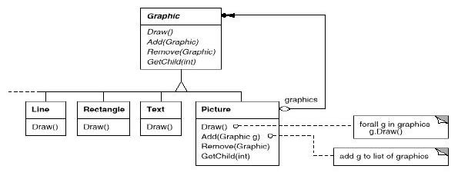
The Composite Pattern
Intent
  Compose objects into tree structures to represent part-whole hierarchies. Composite lets clients treat individual objects and compositions of objects uniformly. This is called recursive composition.
Motivation

Slide 4
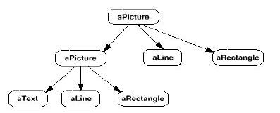
The Composite Pattern
Motivation

Slide 5
The Composite Pattern
Applicability
Use the Composite pattern when
  You want to represent part-whole hierarchies of objects
  You want clients to be able to ignore the difference between compositions of objects and individual objects. Clients will treat all objects in the composite structure uniformly.

Slide 6
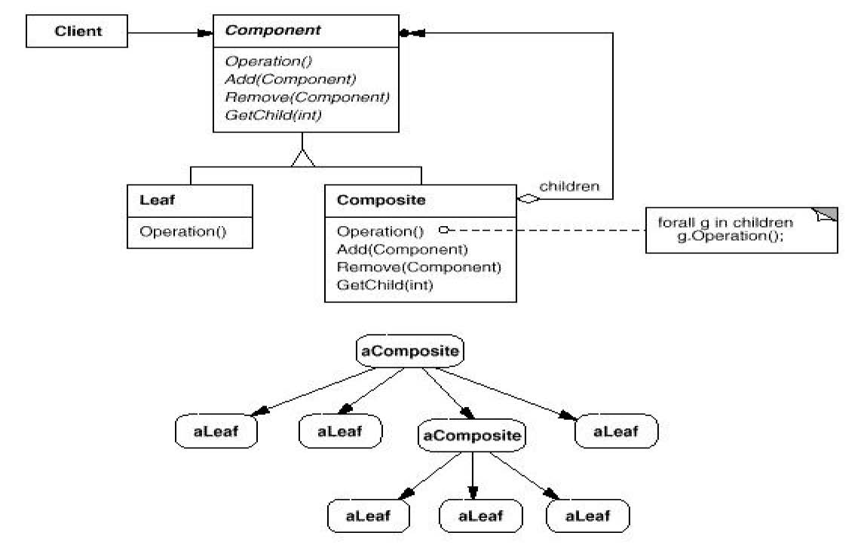
The Composite Pattern
Structure

Slide 7
The Composite Pattern
Consequences
  Benefits
    It makes it easy to add new kinds of components
    It makes clients simpler, since they do not have to know if they are dealing with a leaf or a composite component
  Liabilities
    It makes it harder to restrict the type of components of a composite

Slide 8
The Composite Pattern
Implementation Issues
  A composite object knows its contained components, that is, its children. Should components maintain a reference to their parent component?
    Depends on application, but having these references supports the Chain of Responsibility pattern
  Where should the child management methods (add(), remove(), getChild()) be declared?
    In the Component class: Gives transparency, since all components can be treated the same. But it's not safe, since clients can try to do meaningless things to leaf components at run-time.
    In the Composite class: Gives safety, since any attempt to perform a child operation on a leaf component will be caught at compile-time. But we lose transparency, since now leaf and composite components have different interfaces.

Slide 9
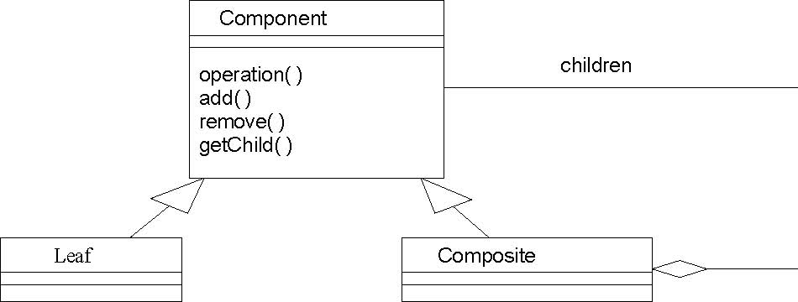
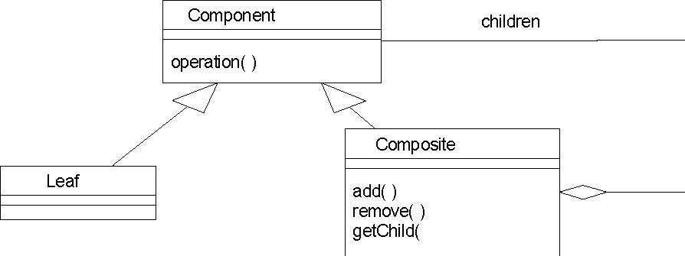
The Composite Pattern
Transparent vs. Safe
TRANSPARENT
SAFE

Slide 10
The Composite Pattern
Implementation Issues
  Should Component maintain the list of components that will be used by a composite object? That is, should this list be an instance variable of Component rather than Composite?
    Better to keep this part of Composite and avoid wasting the space in every leaf object
  Is child ordering important?
    Depends on application
  Who should delete components?
    Not a problem in Java! The garbage collector will come to the rescue!
  What's the best data structure to store components?
    Depends on application
Notes:
有时候系统需要遍历一个树枝构件的子构件很多次，需要把遍历子构件的结果暂时放在父构件里面作为缓冲。

Slide 11
Composite Pattern Example 1
Situation: A GUI system has window objects which can contain various GUI components (widgets) such as, buttons and text areas. A window can also contain widget container objects which can hold other widgets.
Solution 1: What if we designed all the widgets with different interfaces for "updating" the screen? We would then have to write a Window update() method as follows:
public class Window {
    Button[] buttons;
    Menu[] menus;
    TextArea[] textAreas;
    WidgetContainer[] containers;

Slide 12
Composite Pattern Example 1(Continued)
  public void update() {
  if (buttons != null)
  for (int k = 0; k < buttons.length; k++)
  buttons[k].draw();
  if (menus != null)
  for (int k = 0; k < menus.length; k++)
  menus[k].refresh();
  // Other widgets handled similarly.
  if (containers != null)
  for (int k = 0; k < containers.length; k++ )
  containers[k].updateWidgets();
  }
  ...
  }
  Well, that looks particularly bad. It violates the Open-Closed
  Principle. If we want to add a new kind of widget, we have to
  modify the update() method of Window to handle it.

Slide 13
Composite Pattern Example 1(Continued)
Solution 2: We should always try to program to an interface, right? So, let's make all widgets support the Widget interface, either by being subclasses of a Widget class or implementing a Java Widget interface. Now our update() method becomes:
public class Window {
Widget[] widgets;
WidgetContainer[] containers;
public void update() {
if (widgets != null)
for (int k = 0; k < widgets.length; k++)
widgets[k].update();
if (containers != null)
for (int k = 0; k < containers.length; k++ )
containers[k].updateWidgets();
}
}

Slide 14
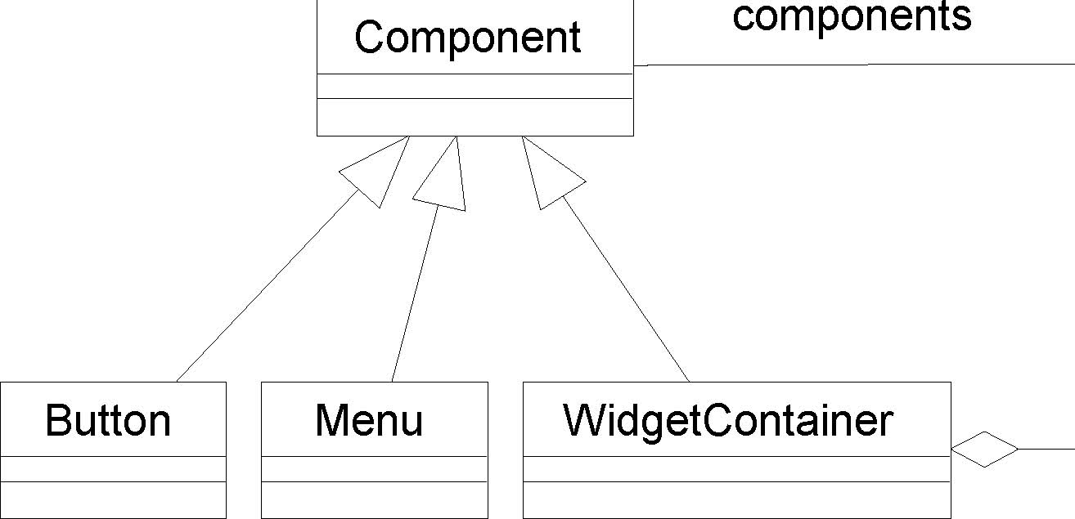
Composite Pattern Example 1(Continued)
That looks better, but we are still distinguishing between widgets and widget containers
Solution 3: The Composite Pattern!

Slide 15
Composite Pattern Example 1(Continued)
Now the update method looks like:
public class Window {
Component[] components;
public void update() {
if (components != null)
for (int k = 0; k < components.length; k++)
components[k].update();
}
}

Slide 16
Summary
The Composite Pattern

